Slide 1
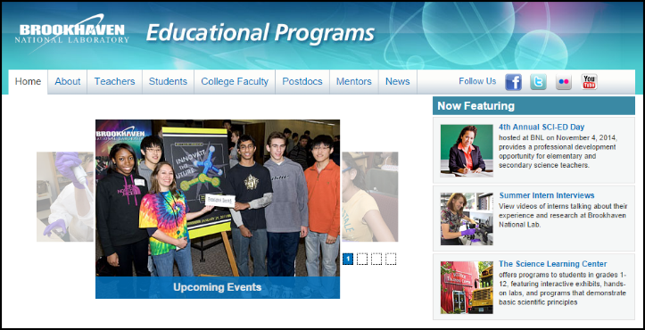
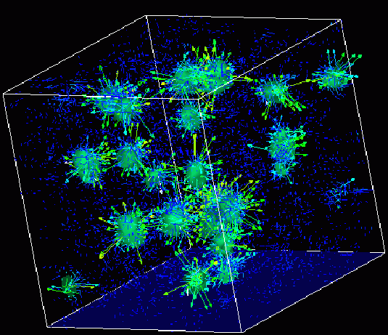
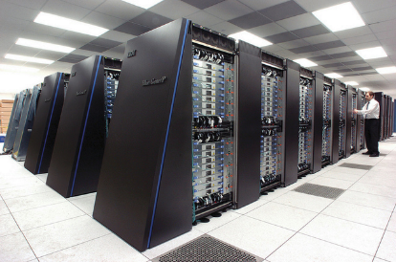
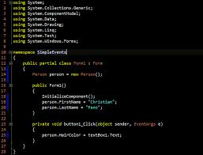
Survey of
Scientific Computing
(SciComp 301)
Dave Biersach
Brookhaven National Laboratory
dbiersach@bnl.gov
Session 14
Cryptanalysis,
Anagrams

Slide 2
Session Goals
Manage a C++ string as a vector<char>
Understand ASCII as an encoding mechanism
Read an ASCII text file stored on disk into a memory buffer
Generate a histogram of character frequencies within a file
Encrypt and decrypt files using “Caesar Shift”
Perform bigram analysis on unreadable cipher text to determine the author’s native language
Generate and discover simple and compound anagrams
Avoid combinatorial (exponential) explosion in search space

Slide 3
C++ strings
A C++ string is mostly equivalent to a vector<char>
A C++ char data type holds one “character”
There is a difference between the length of a string (the number of characters in the string) and the number of bytes required to store it in memory or on disk
The memory size (number of bits) of a character can vary by platform (Windows vs. Linux)
A string has .size() or .length() methods to get the number of characters in the string
We can access individual characters using the .at() method

Slide 4
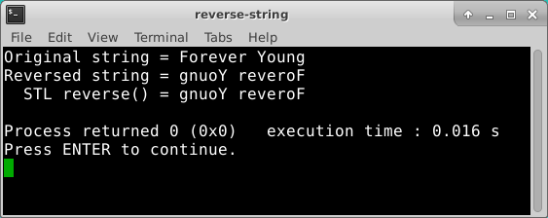
Reverse a String

Slide 5
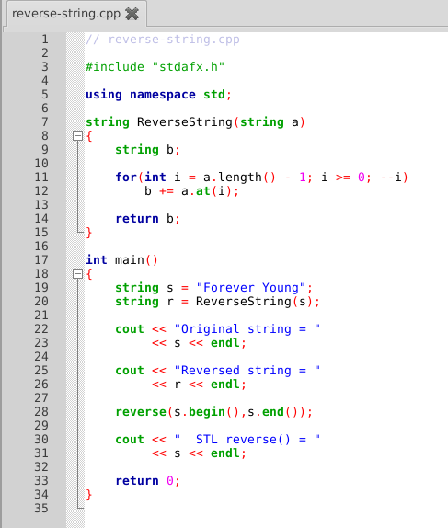
Open Lab 1 Reverse String
Walk backwards through the given string a, while dynamically building string b one character at a time

Slide 6
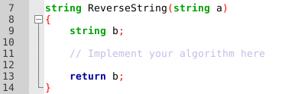

Edit Lab 1 – Reverse String
Add code only to the ReverseString() function – don’t modify any code in main()
A string is an vector – you can access individual elements (characters) using the .at() method
Use .length() to get the number of characters in the string
You can concatenate strings with the + operator
On return, b should be the string a in reverse char order

Slide 7
Edit Lab 1 – Reverse String
Add code only to the ReverseString() function – don’t modify any code in main()
A string is an vector – you can access individual elements (characters) using the .at() method
Use .length() to get the number of characters in the string
You can concatenate strings with the + operator
On return, b should be the string a in reverse char order

Slide 8
Edit Lab 1 Reverse String
Walk backwards through the given string a, while dynamically building string b one character at a time
The C++ Standard Template Library (STL) has a built-in function to reverse the order of the elements in any vector

Slide 9
Run Lab 1 – Reverse String
STL = Standard Template Library
The STL is a set of free & open-source functions and classes to reduce the amount of code C++ programmers must write to solve common problems

Slide 10
ASCII (“as-key”)
American Standard Code for Information Interchange
ASCII was the most common legacy International standard used across the Internet until 2007
Since 2008 ASCII has been surpassed by UTF-8 (Universal Transformation Format), which includes ASCII as a subset
ASCII is an 8-bit (one byte) character encoding scheme
ASCII maps most of the characters in the (Western) languages descending from Latin to a specific integer value
There is a 1:1 correspondence between a letter and a number. In ASCII, every character is always one byte long (in UTF-8 it is variable)
Inside a computer, all letters, punctuation marks, even numbers (when treated as strings) are encoded as either ASCII or UTF

Slide 11
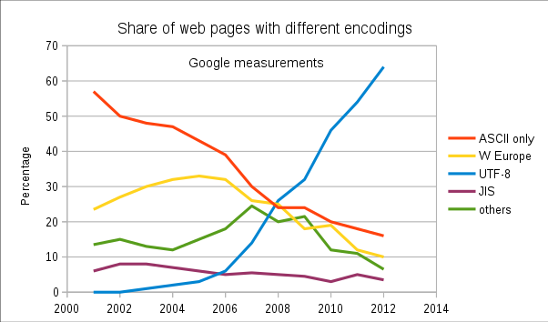
Learn about UTF-8
https://en.wikipedia.org/wiki/UTF-8

Slide 12
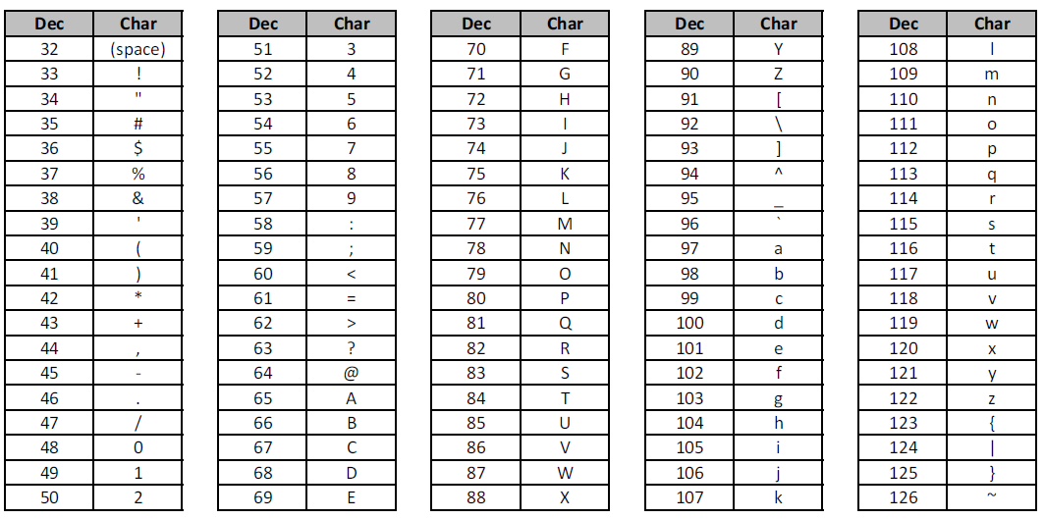
ASCII range for common English characters

Slide 13

ASCII Text Files – A “stream”
A file on disk is essentially just a big byte array
A byte is an 8-bit unsigned integer between 0 and 255 (uint8_t)
We can declare a byte array and load it with the contents of a file
A stream of file bytes in memory is called a buffer
We can then access any individual character within the disk file by using the normal .at() method on the vector fileBytes and specifying an index value

Slide 14
Creating a Frequency Histogram
Consider Lincoln’s Gettysburg Address:
Four score and seven years ago our fathers brought forth on this continent a new nation, conceived in liberty, and dedicated to the proposition that all men are created equal.
Now we are engaged in a great civil war, testing whether that nation, or any nation so conceived and so dedicated, can long endure…
We want to perform a histogram analysis of Lincoln’s speech
What letter do you think occurs most frequently in English?
Spaces (ASCII value 32) usually occur most often because we use spaces as a word breaker

Slide 15
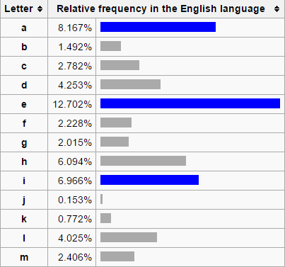
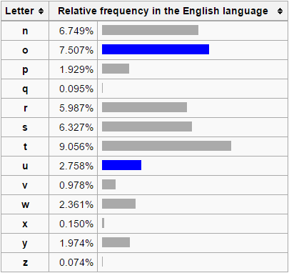
Letter Frequencies in the English Language

Slide 16
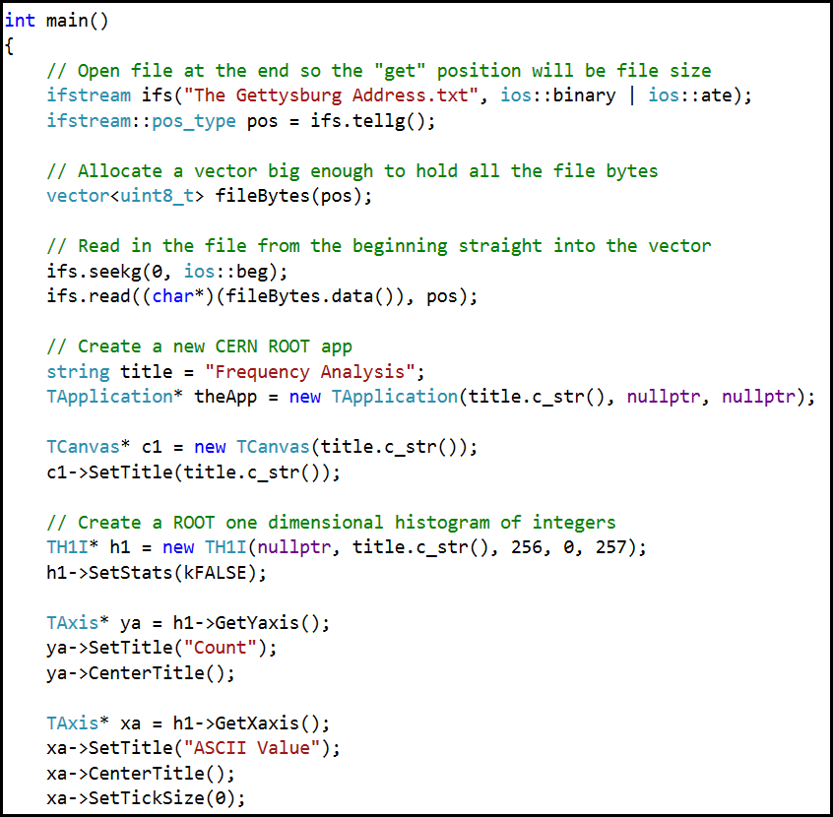
Open Lab 2 Frequency Histogram

Slide 17
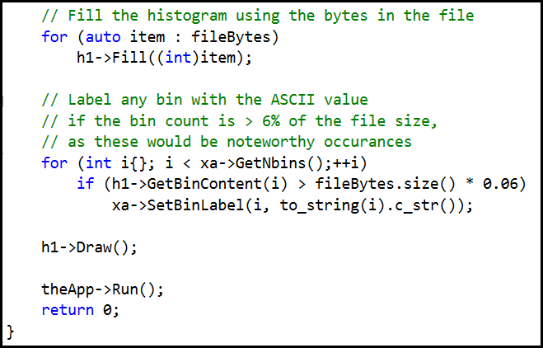
View Lab 2 Frequency Histogram
Run Lab 2

Slide 18
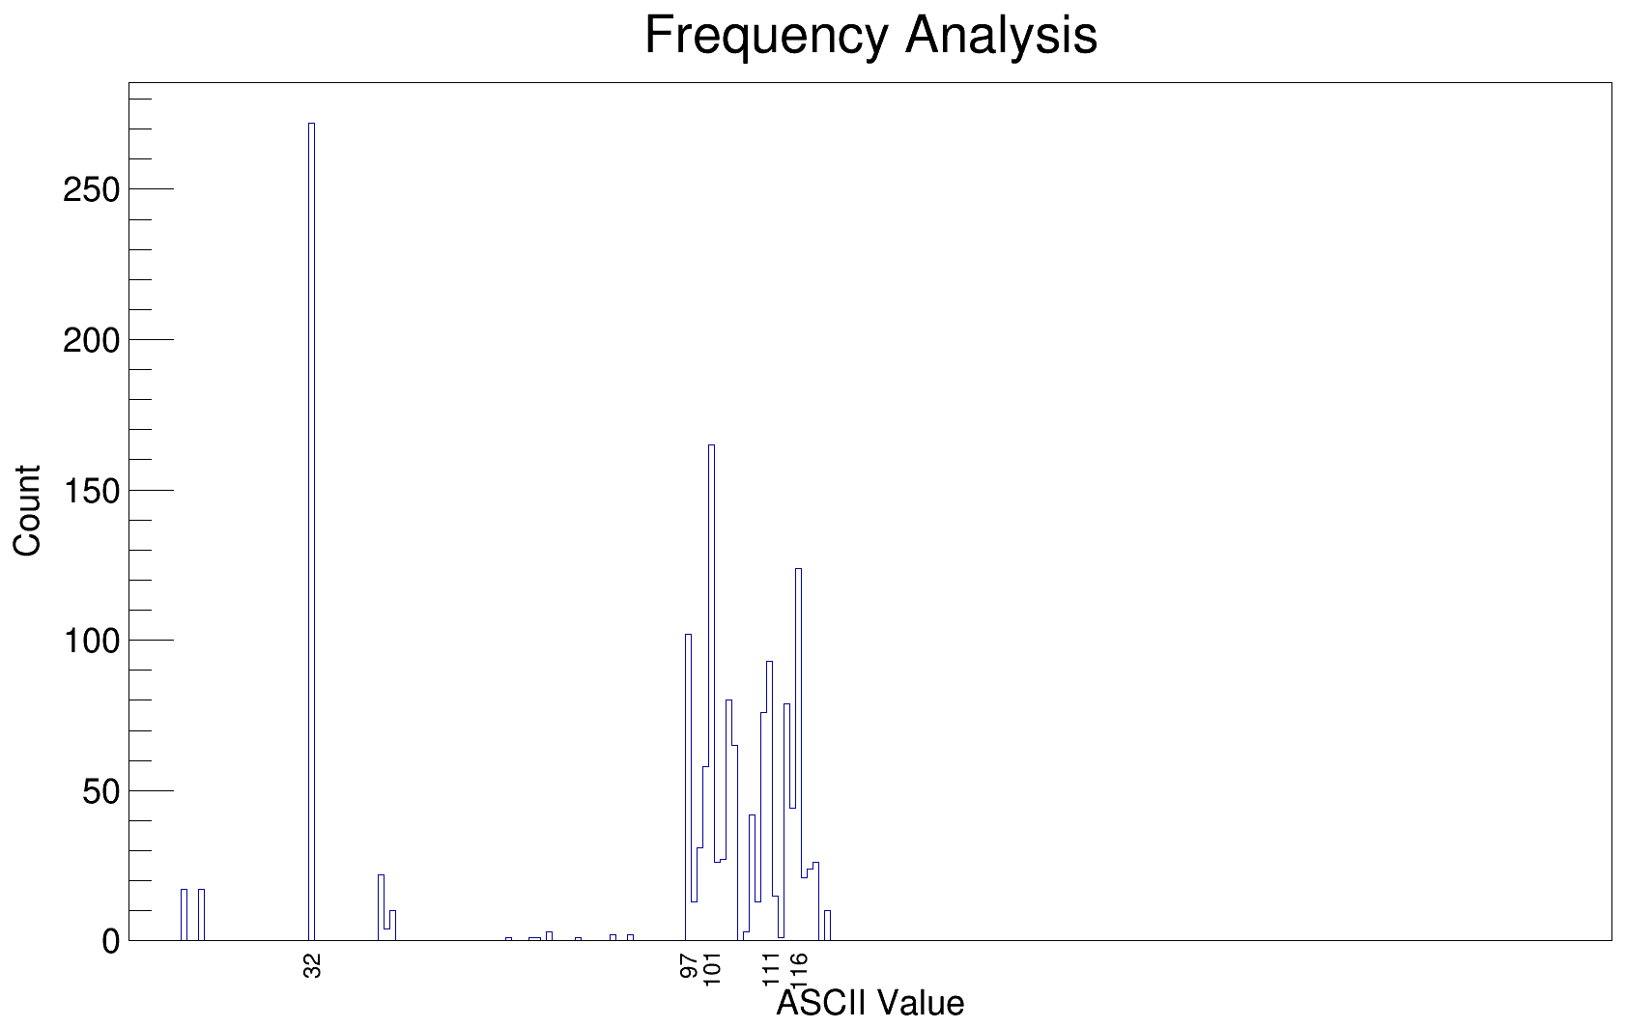
Histogram of Lincoln’s Gettysburg Address
ASCII value 32 (space) appears most often

Slide 19
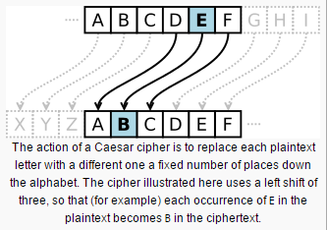
The Caesar Shift Cipher
Roman Emperor Julius Caesar used a simple (but effective for its time) encryption scheme for his private correspondence
To create “cipher text” from “plain text” simply shift the original letters forward (or backward) a given number of letters in the alphabet
To decrypt the message, simply reverse the sign of the shift

Slide 20
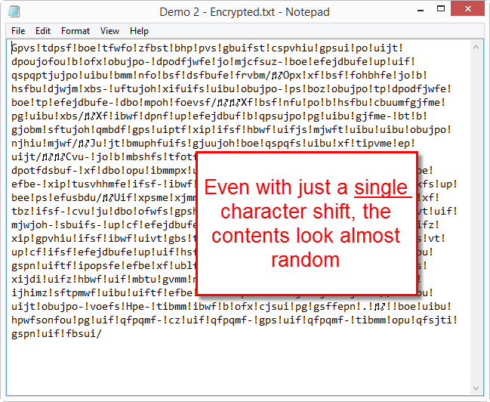
The Caesar Shift Cipher

Slide 21
The Caesar Shift Cipher
The question becomes, if we are given a “Caesar Shift” encrypted file, which we believe was written in English, how can we figure out what shift was used?
We could use “brute force” and try every possible value to see what shift produces legible prose
We only need to try shifts between 1 and 255 – why?
But it would still take a long time to sift through potentially 255 distinct files all filled with gibberish in order to break the cipher
Can we gleam any insight from analyzing the character histogram of the encrypted file?

Slide 22
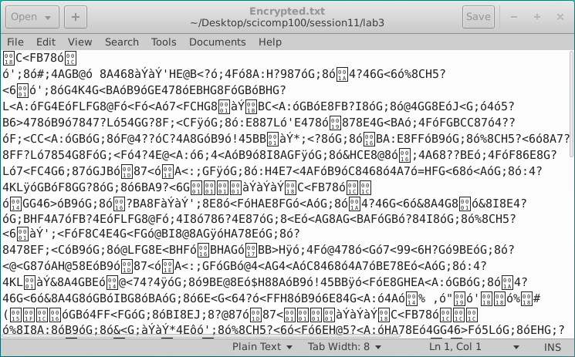
Open Lab 3 – Ciphertext.txt
Good luck with that!

Slide 23
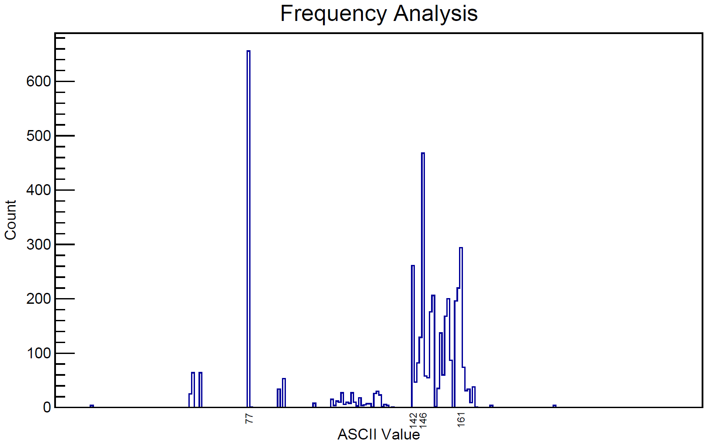
Run Lab 3 – Histogram of Ciphertext
What shift value was used for this Caesar encryption?
Run Lab 3

Slide 24
Open Lab 4 – Caesar Decrypt
Your mission is to decrypt the Lab 3 ciphertext file
What if the survival of your country depended upon your ability to crack the encryption?

Slide 25
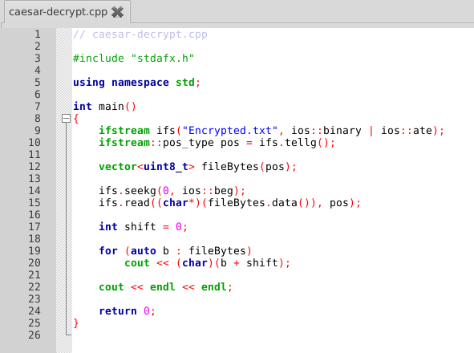
Edit Lab 4 – Caesar Decrypt
What shift value was used for the Lab 3 Caesar encryption?

Slide 26
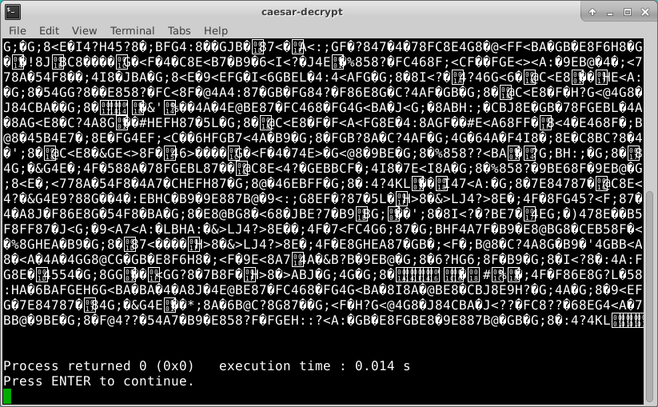
Run Lab 4 – Caesar Decrypt

Slide 27
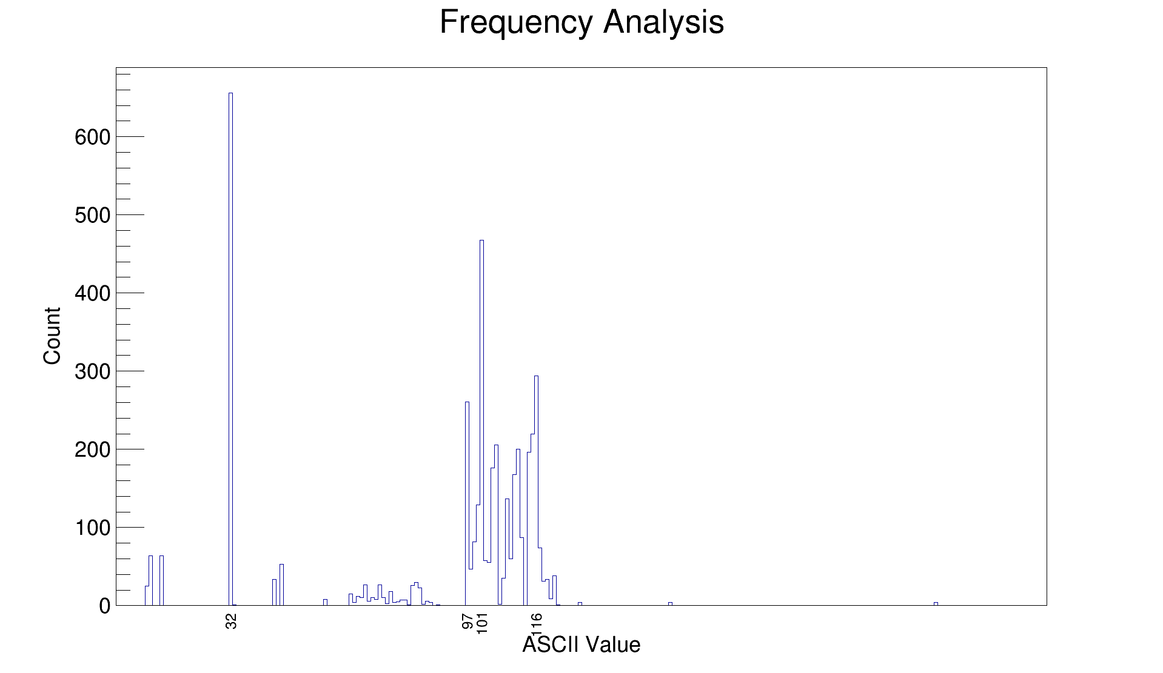
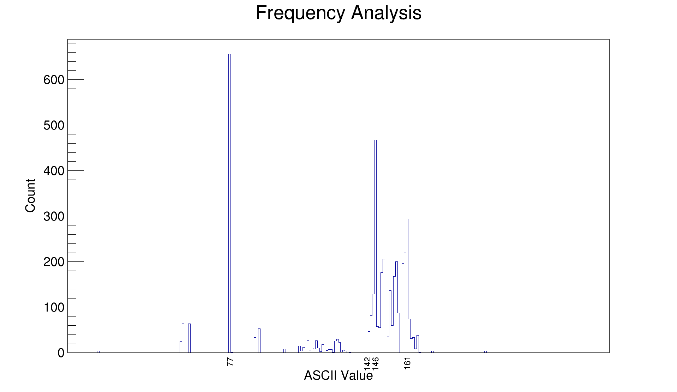
plaintext
Notice the relative frequencies are the same before and after encryption
ciphertext

Slide 28
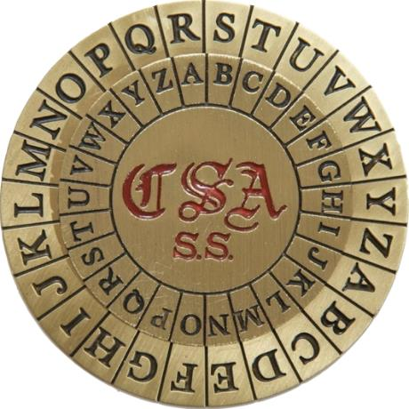
The Caesar Shift Cipher
Because the Caesar Shift is a monoalphabetic substitution cipher, it is susceptible to cryptanalysis (breaking) by frequency analysis

Slide 29
Bigram Analysis
Most Western (Latin influenced) languages have a unique fingerprint from their most frequent bigrams (two-letter pair)
In English the bigrams TH and HE occur most often, since “the” is the most frequent word in English
“The” also occurs very often in other languages, though each language spells it differently, and this helps establish the distinct statistical profiles of each language
Linguists and statisticians have compiled lists of the most frequent bigrams per language
We will analyze the bigrams in President Kennedy’s Rice University Speech - where he set the goal in 1962 for the USA to reach the moon before 1970!

Slide 30
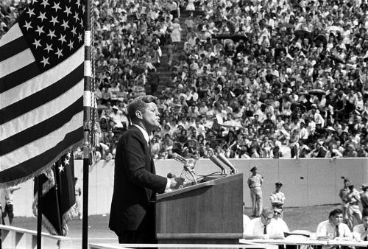
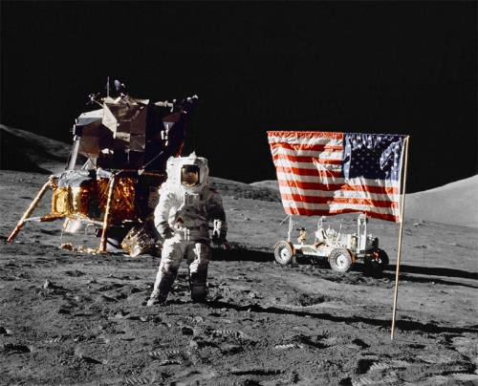
Kennedy’s Moon Speech in 1962
“We choose to go to the moon in this decade and do the other things, not because they are easy, but because they are hard, because that goal will serve to organize and measure the best of our energies and skills, because that challenge is one that we are willing to accept, one we are unwilling to postpone, and one which we intend to win.”

Slide 31
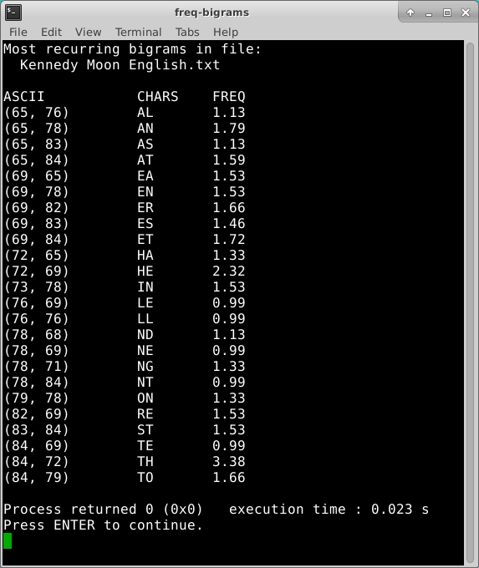
Bigram Analysis of Kennedy’s Moon Speech (English)

Slide 32
Kennedy’s Moon Speech Translated
Nous choisissons d'aller sur la lune. Nous choisissons d'aller sur la lune dans cette décennie et de faire d'autres choses, non pas parce qu'ils sont faciles, mais parce qu'ils sont difficiles, parce que ce but servira à organiser et mesurer le meilleur de nos énergies et de compétences, parce que ce défi est l'un que nous sommes prêts à accepter, que nous ne sommes pas disposés à reporter, et celui qui nous avons l'intention de gagner.
Elegimos ir a la Luna. Elegimos ir a la Luna en esta década y hacer las otras cosas, no porque sean fáciles, sino porque son difíciles, porque esa meta servirá para organizar y medir lo mejor de nuestras energías y habilidades, porque ese desafío es uno que estamos dispuestos a aceptar, uno no estamos dispuestos a posponer, y uno que tenemos la intención de ganar.
Wir wählen, um zum Mond zu fliegen. Wir wählen, um zum Mond in diesem Jahrzehnt zu gehen und die anderen Dinge, nicht weil sie leicht sind, sondern weil sie hart sind, denn das Ziel wird dazu dienen, zu organisieren und zu messen, das Beste aus unserer Energien und Fähigkeiten, denn das ist eine Herausforderung dass wir bereit sind zu akzeptieren, das wir nicht bereit sind, zu verschieben, und eine, die wir beabsichtigen, zu gewinnen.

Slide 33
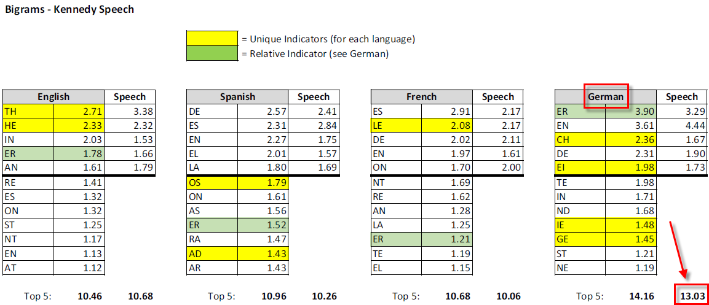
Bigram Statistics by Language
German is the most consistent language for bigrams

Slide 34
Bigram Analysis
You have been given another encrypted message!
It is encrypted with a monoalphabetic substitution cipher, but single letter frequency analysis does not show any consistent Caesar shifting – it appears to be a different shift for each plaintext letter
Even if you are unable to break the encryption, can you tell what language was used to author the plaintext?
Q: Are you serious? How can you possibly discern the author language if you cannot even read the contents in the first place?
A: Enigma was also unbreakable

Slide 35
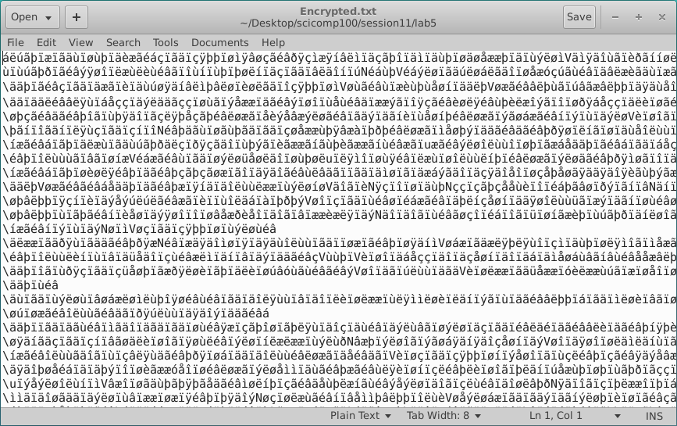
Open Lab 5 – Ciphertext.txt
Good luck with that!

Slide 36
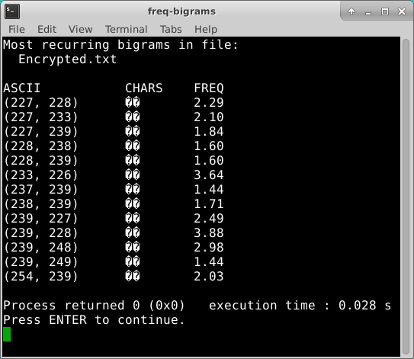
Run Lab 5 – Bigram Analysis
Consider the frequencies of the most recurring bigrams in the cipher text.
What language has this level of bigram consistency?

Slide 37
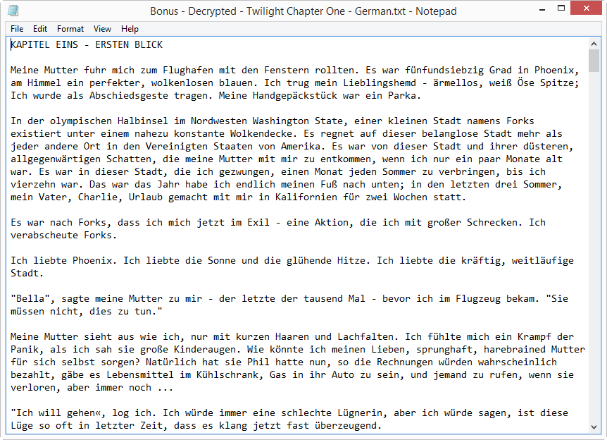
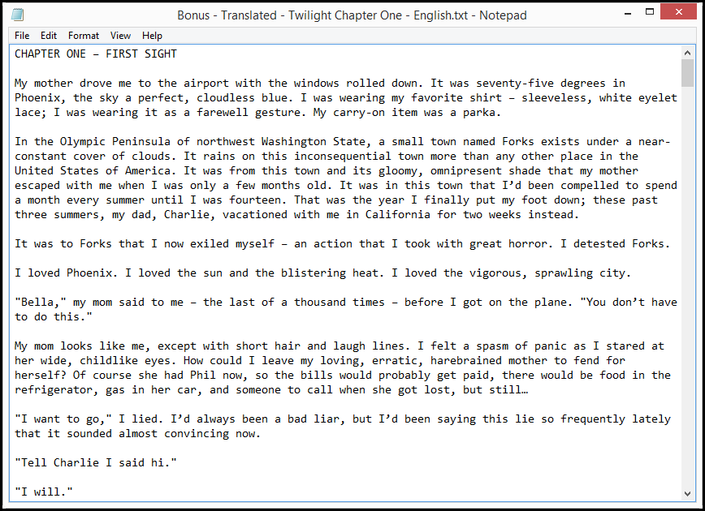
Lab 5 – Bigram Analysis

Slide 38
Anagrams
Different words all spelled with the same set of letters are called anagrams
Given an English dictionary, how could you find all the anagrams of a word?
What algorithm would you use? Trial and error?
Word | Letters | Anagrams | Permutations
STOP | 4 | 6 | 24
LEAST | 5 | 10 | 120
TRACES | 6 | 9 | 720
PLAYERS | 7 | 7 | 5,040
RESTRAIN | 8 | 6 | 40,320
MASTERING | 9 | 4 | 362,880
SUPERSONIC | 10 | 3 | 3,628,800

Slide 39
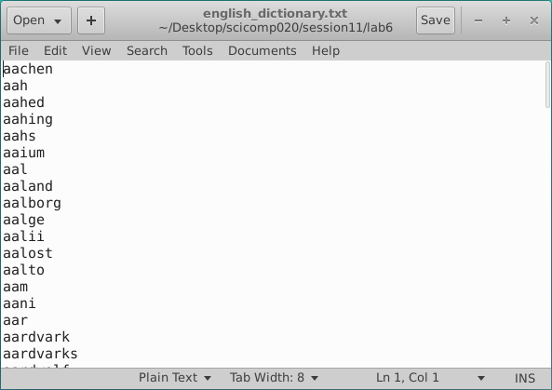
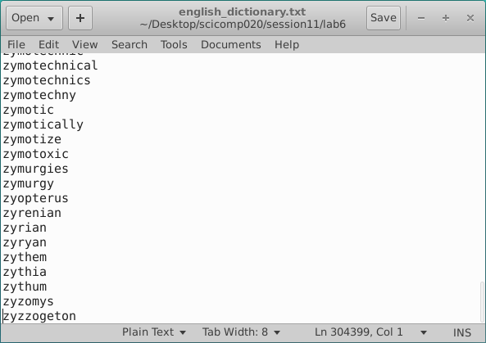
Anagrams

Slide 40
Anagrams
stop = post, pots, spot, tops
least = slate, stale, steal, tales
traces = carets, caster, caters, crates, reacts, recast
players = parsley, parleys, replays, sparely
restrain = retrains, strainer, terrains, trainers
mastering = ???
supersonic = ???
Naive Approach = Try every possible permutation of all given letters, checking in dictionary file to see if that permutation it is a valid English word

Slide 41
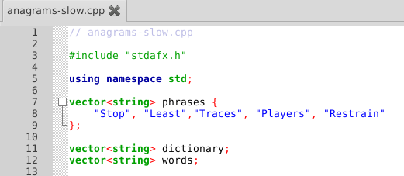
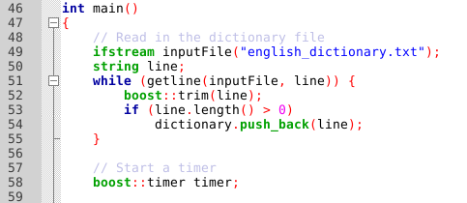
Open Lab 6 – Slow Anagrams

Slide 42
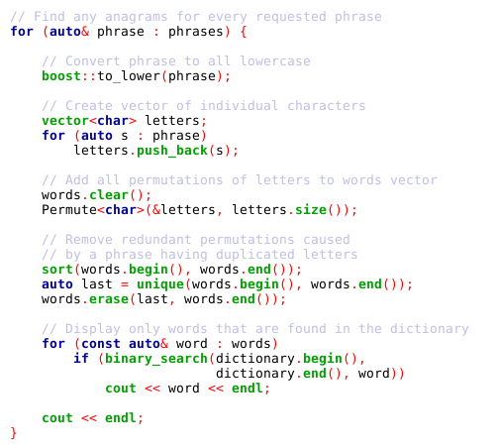
View Lab 6 Slow Anagrams

Slide 43
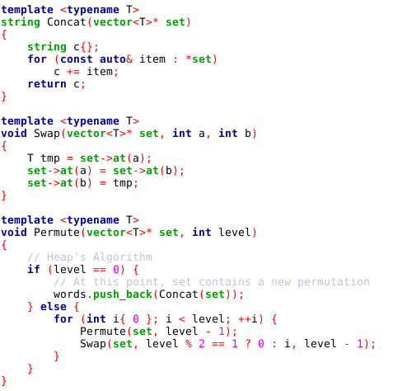
View Lab 6 Slow Anagrams

Slide 44
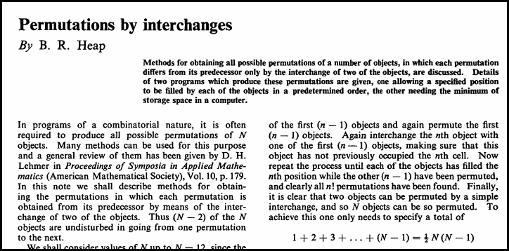
Lab 6 – Slow Anagrams
1963

Slide 45
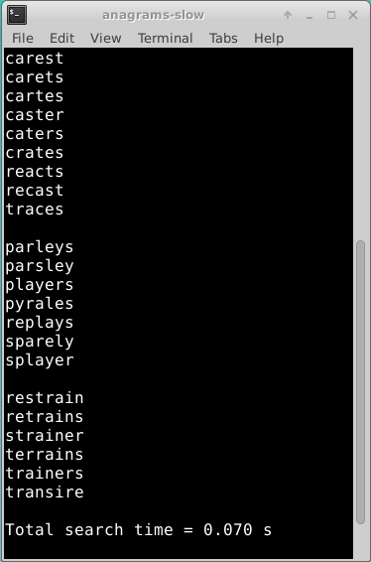
Run Lab 6 – Slow Anagrams
Stop
Least
Traces
Players
Restrain

Slide 46
Anagrams
stop = post, pots, spot, tops
least = slate, stale, steal, tales
traces = carets, caster, caters, crates, reacts, recast
players = parsley, parleys, replays, sparely
restrain = retrains, strainer, terrains, trainers
mastering = ???
supersonic = ???
Novel Approach - Thinking in reverse! First, SORT the given dictionary file by word letter order, then SEARCH for equal first columns (e.g. “OPST”) to find all anagrams in the dictionary

Slide 47
A way of finding anagrams that much
faster than by trying every permutation!
POSSUM |  | M | O | P | S | S | U |  |  | MOPSSU
POST |  | O | P | S | T |  |  |  |  | OPST
POSTAGE |  | A | E | G | O | P | S | T |  | AEGOPST
POTION |  | I | N | O | O | P | T |  |  | INOOPT
POTS |  | O | P | S | T |  |  |  |  | OPST
POUCH |  | C | H | O | P | U |  |  |  | CHOPU
SPOT |  | O | P | S | T |  |  |  |  | OPST
SPOUSE |  | E | O | P | S | S | U |  |  | EOPSSU
STOP |  | O | P | S | T |  |  |  |  | OPST
TOPICS |  | C | I | O | P | S | T |  |  | CIOPST
TOPS |  | O | P | S | T |  |  |  |  | OPST
TORCH |  | C | H | O | R | T |  |  |  | CHORT

Slide 48
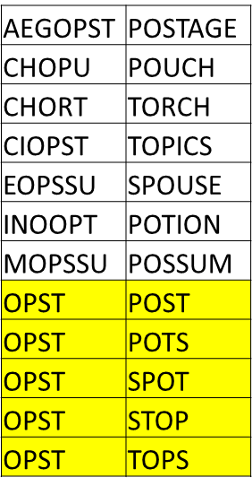
MOPSSU | POSSUM
OPST | POST
AEGOPST | POSTAGE
INOOPT | POTION
OPST | POTS
CHOPU | POUCH
OPST | SPOT
EOPSSU | SPOUSE
OPST | STOP
CIOPST | TOPICS
OPST | TOPS
CHORT | TORCH

Slide 49
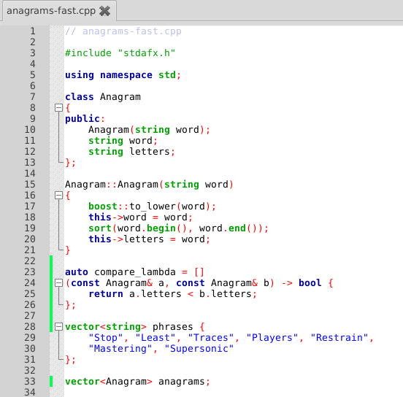
Open Lab 7 Fast
Anagrams

Slide 50
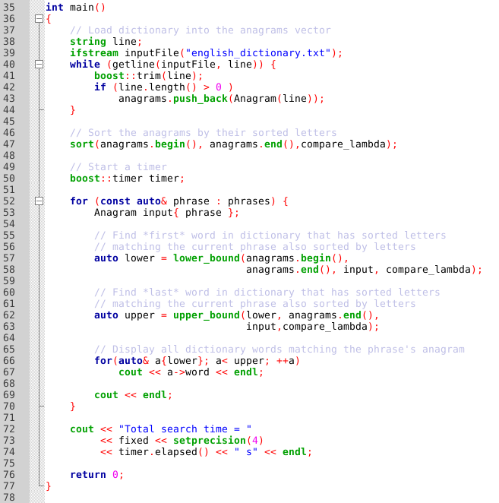
View Lab 7 Fast
Anagrams

Slide 51
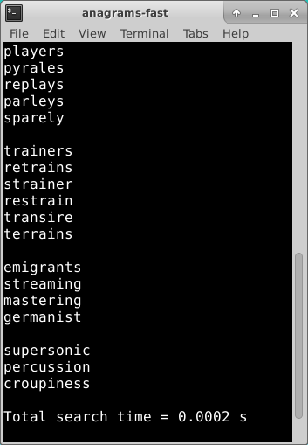
Run Lab 7 – Fast Anagrams
Stop
Least
Traces
Players
Restrain
Mastering
Supersonic

Slide 52
Slow vs. Fast Anagrams
Slow Anagram approach took 700 ms while the Fast Anagram approach took 2ms – that is a 350X speedup despite including 3 additional (longer) phrases!
Even binary searching (as used in Lab 6) cannot overcome the penalty of enumerating over permutations which could never be valid English words – this is the inherent problem with the Slow Anagram approach
The dictionary defines the search space – don’t expand the search space by testing unconstrained permutations – this leads to combinational explosion
Supersonic has 3M letter permutations, but only 3 anagrams
Elvis = Lives . . . Listen = Silent

Slide 53
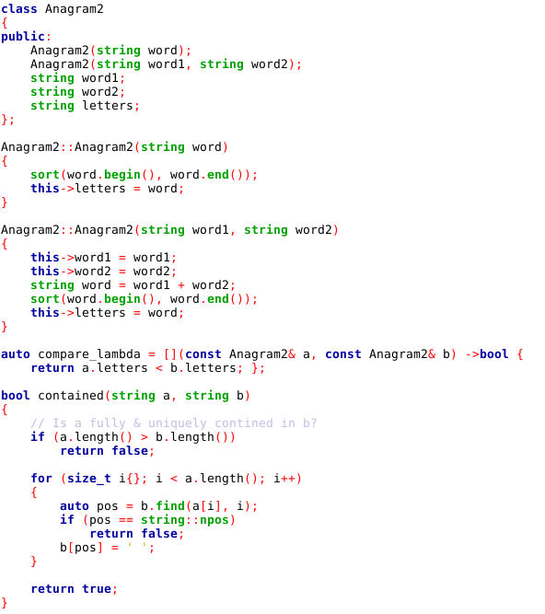
Open Lab 8 Compound
Anagrams
What two smaller words can be made out of the letters in the word dormitory?
$$\text{room}\text{ (}\text{moor}\text{)}≈\text{dormitory}\text{ (}\text{dimoorrty}\text{)}$$

Slide 54
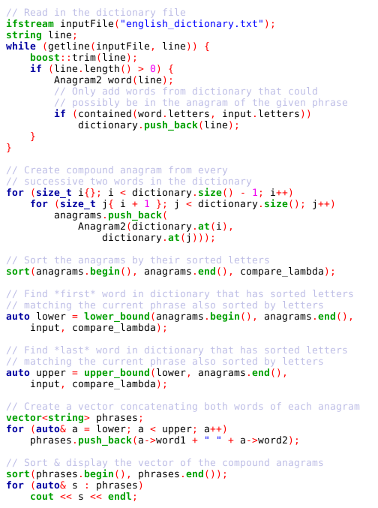
View Lab 8 Compound
Anagrams
dormitory (dimoorrty) $=$ dirty room (dimoorrty)

Slide 55
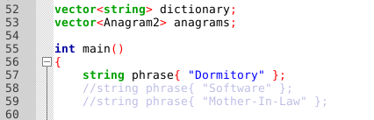
Edit Lab 8 - Compound Anagrams
Enable the other phrases to reveal lurking compound anagrams.. ☺

Slide 56


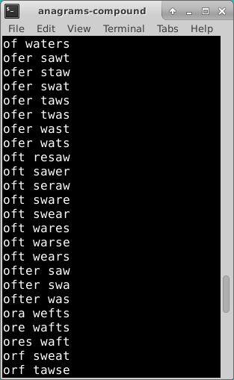
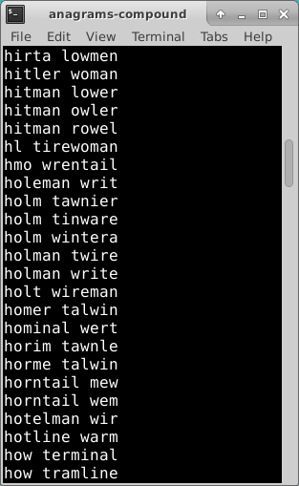
Run Lab 8 - Compound Anagrams
NOTICE:
You didn’t hear this one from me! ☺

Slide 57
Who knew?
The Morse Code = Here come dots
The meaning of life = The fine game of nil
Statue of Liberty = Built to stay free

Slide 58
Now you know…
C++ strings are essentially a vector of type char
ASCII is an international standard for encoding most Western language characters into a single byte
Character histograms enable frequency analysis
Caesar-Shift ciphers are not very secure
All monoalphabetic substitution ciphers can be broken with bigram analysis
Using “brute force” to crack a cipher is often intractable – get statistics on your side to help you out!
Heap’s Algorithm will generate all permutations of a set
Consider problems backwards: don’t expand search spaces

